Slide 1




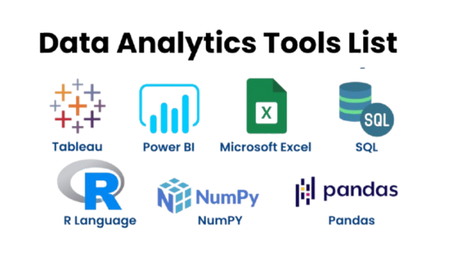

MBA Program Funnel Analysis – Marketing & Admissions Journey
Notes:
1.7.2013
1
‹#›

Slide 2



Objectives
Perform data cleaning and preprocessing of raw MBA-Tech application, test, token, and marketing datasets to ensure consistency and usability.
Conduct exploratory data analysis (EDA) to identify patterns, trends, and anomalies in leads, applications, tests, and token usage.
Develop a funnel analysis to track the conversion journey from leads to successful MBA-Tech enrollments.
Evaluate the performance of marketing campaigns by analyzing lead generation effectiveness and conversion rates.
Build predictive models (Logistic Regression, Random Forest) to forecast applicant success and improve selection or targeting strategies.
Generate actionable insights and recommendations through reports and visualizations to support decision-making for MBA-Tech admissions and marketing strategy.
Notes:
1.7.2013
3
‹#›

Slide 3

The Journey of EDA: Key Steps
01
02
03
Data Collection
Data Wrangling
Exploratory Visualization
Gathering relevant data from diverse sources.
Cleaning and structuring data for analysis.
Creating visual summaries to spot patterns.
04
05
06
Descriptive Statistics
Missing Value Treatment
Outlier Analysis
Summarizing data with measures like mean, median, and mode.
Handling gaps and missing entries in the dataset.
Identifying and managing extreme data points.
07
08
09
Data Transformation
Dimensionality Reduction
Bivariate Exploration
Adjusting data distributions for better model performance.
Simplifying data by reducing the number of variables.
Examining relationships between two variables.
10
11
Multivariate Exploration
Communication of Insights
Analyzing relationships among multiple variables.
Presenting findings clearly and effectively.
Notes:
1.7.2013
2
‹#›

Slide 4
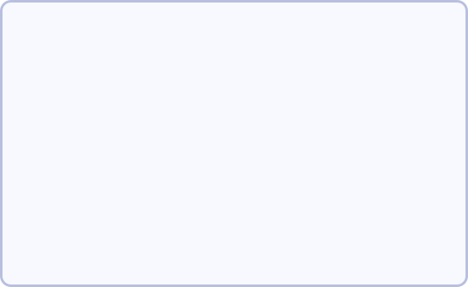
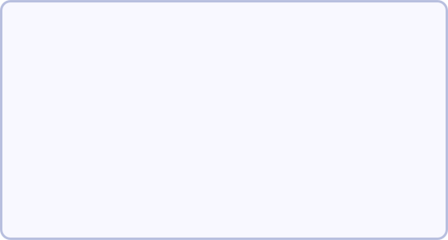
Obj-1
Data Cleaning & Wrangling: Preparing for Purity
Before analysis, data must be meticulously cleaned and structured. Our process involves:
Column Management
Standardization
Type Conversion
Dropped columns that were entirely empty to streamline the dataset and remove irrelevant features.
Ensured consistency in categorical data (e.g., converting "Facebook" to "facebook") to prevent misclassification and improve aggregation.
Converted numeric strings into float data types, allowing for mathematical operations and accurate calculations.
Outlier Handling
Missing Value Imputation
Utilized IQR (Interquartile Range) and Z-score methods to identify and remove extreme outliers that could skew analysis.
Strategically filled missing values using the median for numerical data and mode for categorical data, maintaining data integrity.
Notes:
1.7.2013
4
‹#›

Slide 5

Dataset Explanation: Overview
Our analysis leverages five distinct yet interconnected datasets, each representing a crucial stage in the MBA admissions funnel.
Leads
19.9K+
Initial contact information, source, demographics.
Applications
~5–6K
Personal & academic history, work experience, lead stage.
Tests
~200–500
Candidate performance, test scores, demographics.
Tokens
~85–100
Payment status, offer details, loan processing information.
Enrollments
~60–70
Final enrolment status, programme details.
Each dataset provides unique insights into the candidate's journey, collectively painting a comprehensive picture of the admission funnel.
Notes:
1.7.2013
5
‹#›

Slide 6
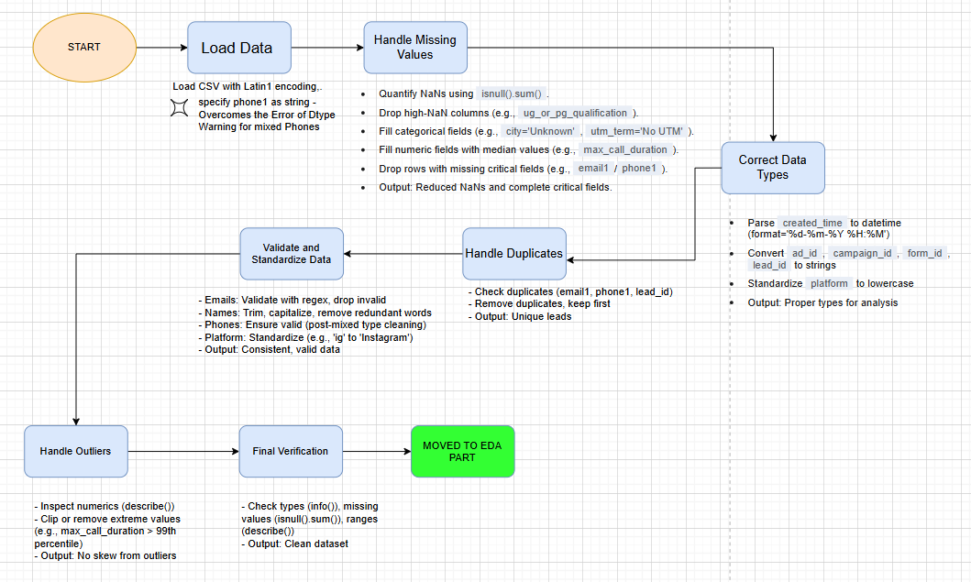
LEADS DATA SET
Notes:
1.7.2013
1. Handling Mixed Data Types
Reason: Mixed data types in a single column (phone1) can break functions and lead to errors in analysis. Converting these columns to a uniform type ensures that all entries can be processed correctly. For IDs, converting from float to string prevents precision loss with large numbers.
2. Managing Missing Values (NaNs)
Reason: Missing data can skew analysis, leading to incorrect conclusions. We fill non-critical columns to preserve valuable rows, while dropping rows with missing critical information (email1, phone1) because these are essential for a lead to be considered valid.
3. Removing Duplicates
Reason: Duplicate entries inflate metrics and lead to an inaccurate understanding of the dataset. Removing duplicates ensures each row represents a unique lead, providing a more accurate count and reliable analysis of metrics like conversion rates.
4. Standardizing Data
Reason: Inconsistent entries for the same category (e.g., 'ig' and 'Instagram') make it difficult to group, filter, or count data accurately. Standardizing these values ensures that all entries for a specific category are uniform, making the data ready for reliable categorical analysis.
‹#›

Slide 7
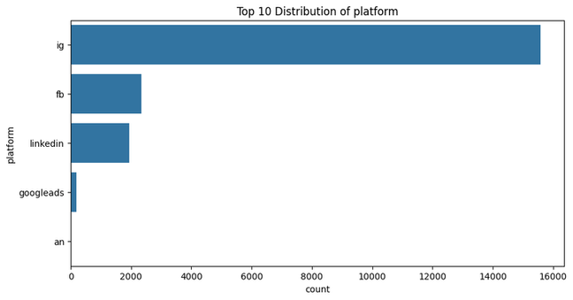
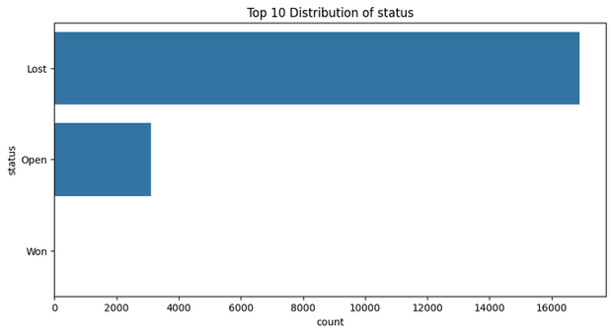
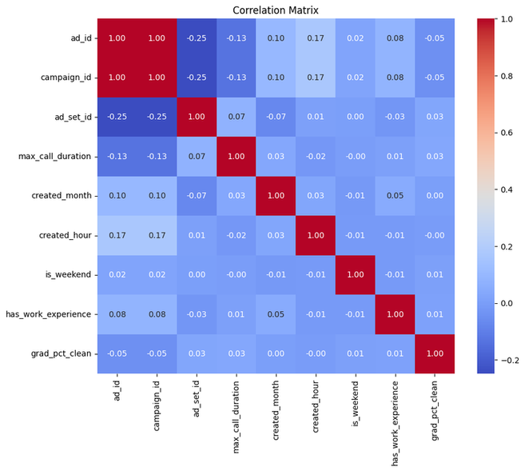
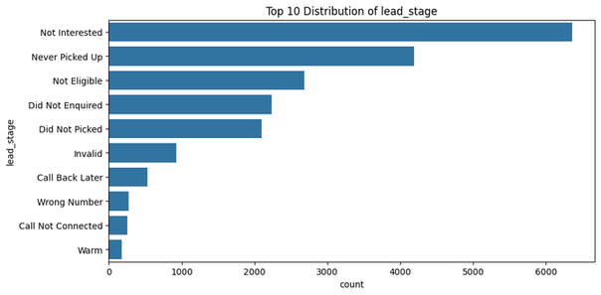
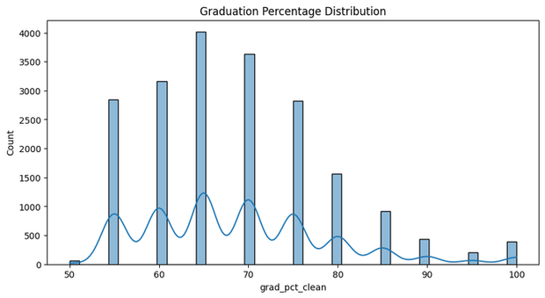
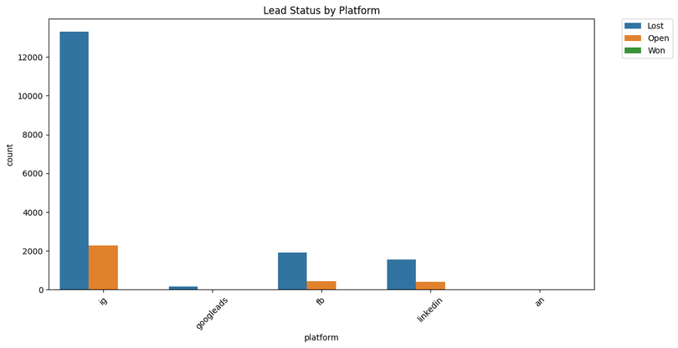
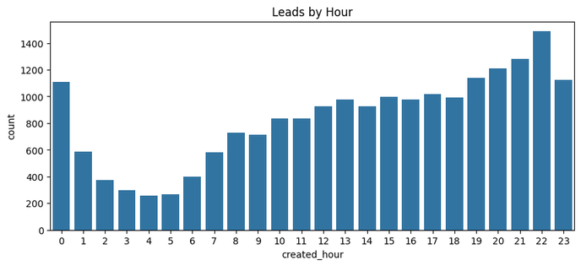
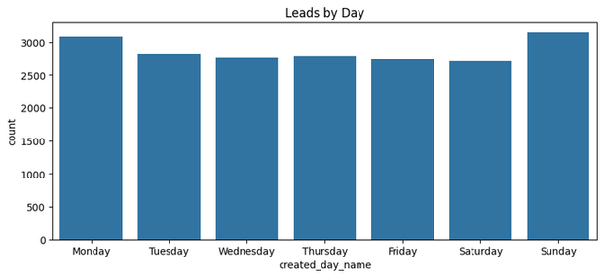
INSIGHTS AFTER EDA

Slide 8

Applications Dataset: Candidate Profiles
The Applications dataset captures detailed information submitted by prospective MBA candidates, forming a crucial bridge between initial leads and academic assessment.
Key Information: Personal history, academic qualifications, and professional work experience.
Funnel Link: Includes the lead stage at the time of application submission, allowing for tracking of conversion rates from leads.
Assessment Data: Also contains initial test scores, providing a preliminary filter for candidate suitability.
Volume: Comprises approximately 5,000–6,000 applications, indicating a significant number of interested candidates moving forward from the lead stage.
Notes:
1.7.2013
7
‹#›

Slide 9
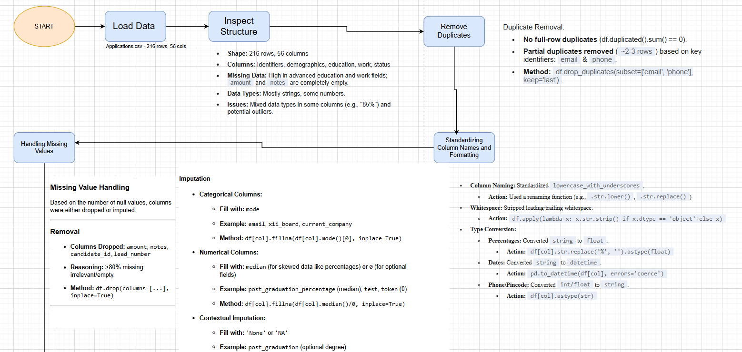
P.T.O
APPLICATION DATA SET
Notes:
1.7.2013
‹#›

Slide 10
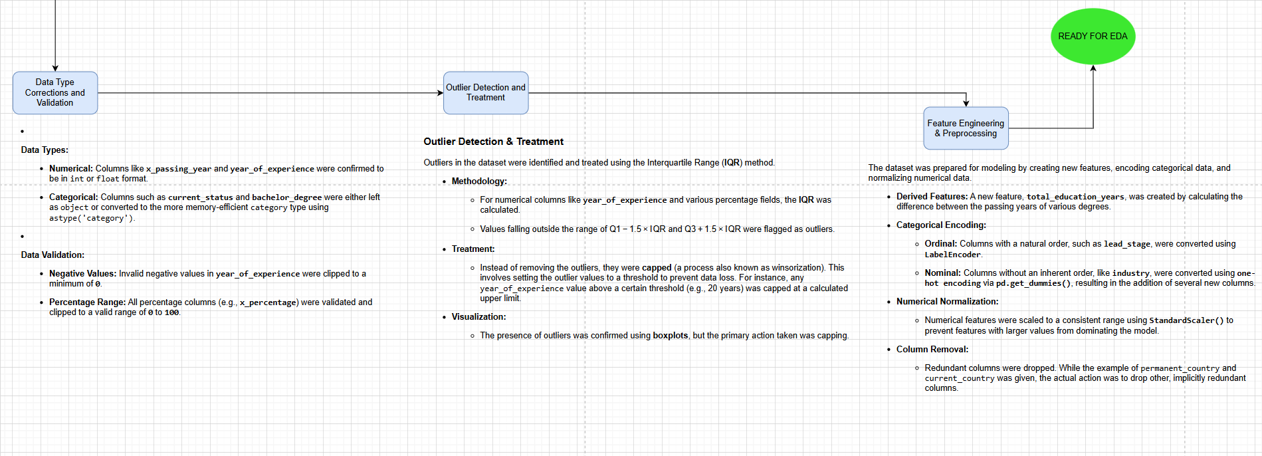
Notes:
1.7.2013
‹#›

Slide 11
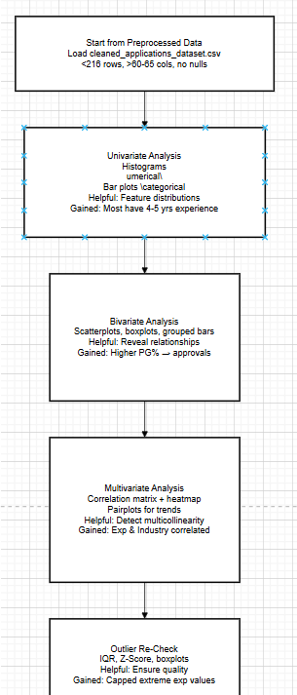
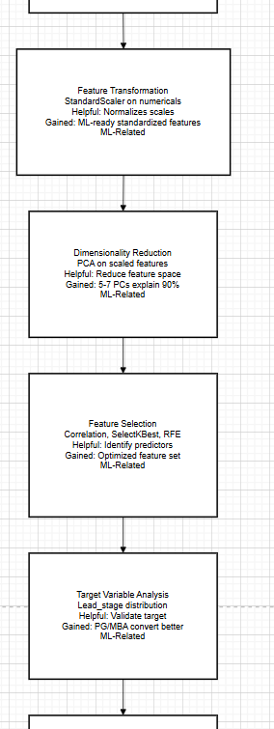
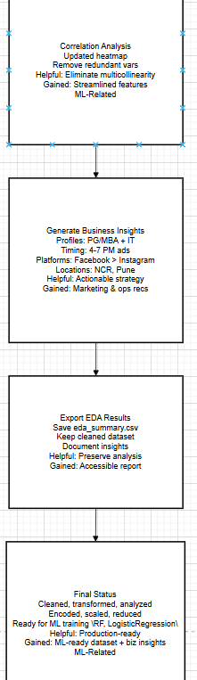
EDA

Slide 12
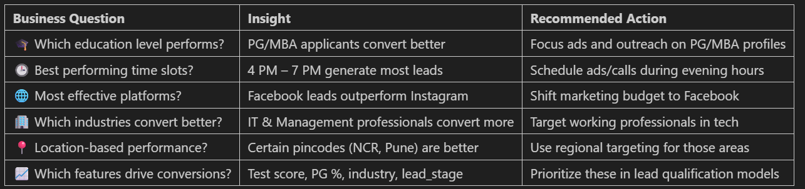
INSIGHTS AFTER EDA

Slide 13

Tests Dataset: Performance & Demographics
The Tests dataset provides essential data on candidate performance and demographics during the assessment phase of the MBA admission process.
Records: 200–500 test records, detailing the outcomes of the admissions examinations.
Key Data Points: Includes candidate test scores, which are vital for academic evaluation, and demographic information, enabling analysis of applicant diversity and potential biases.
This dataset is critical for evaluating the effectiveness of the testing phase and understanding the profile of candidates who successfully clear this hurdle.
Notes:
1.7.2013
8
‹#›

Slide 14
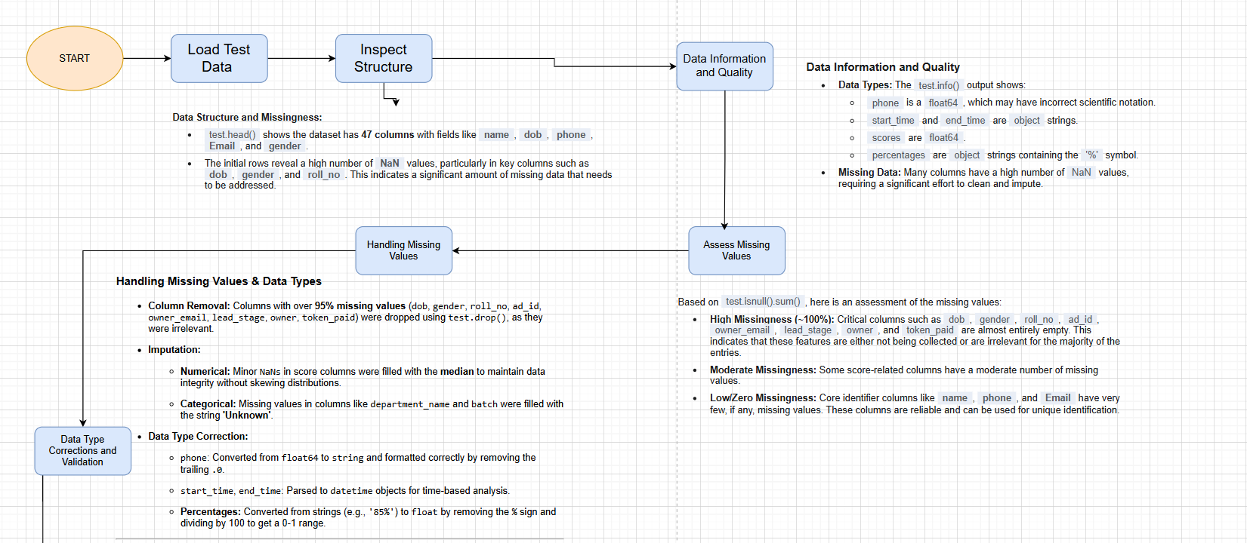
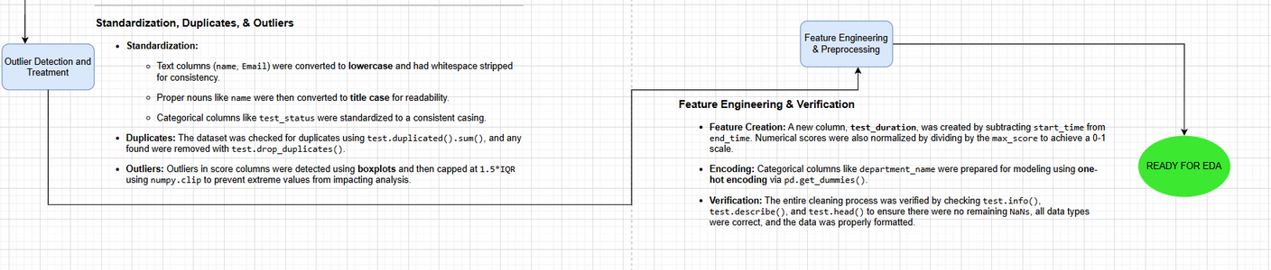
TEST DATASET
Notes:
1.7.2013
‹#›

Slide 15
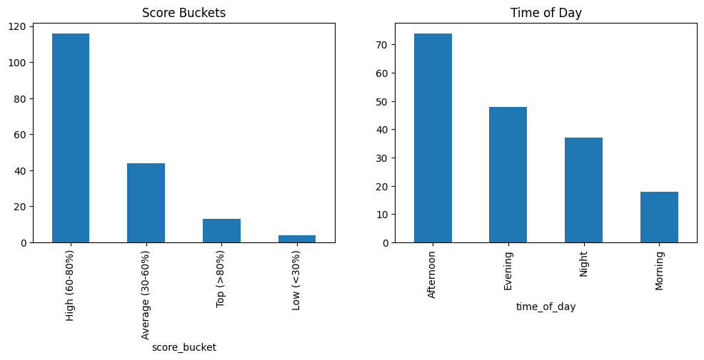
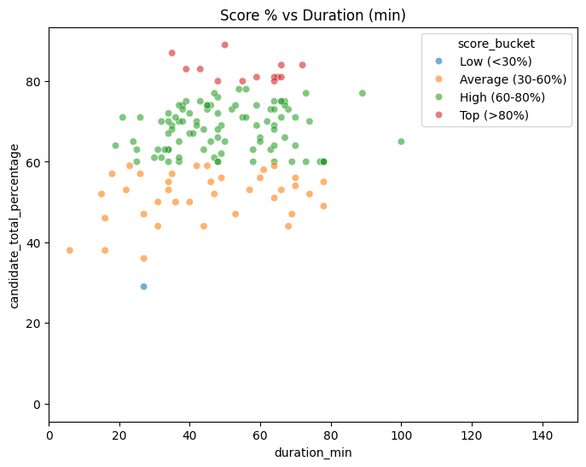
KEY-> EDA OUTPUT
Implications:
Suggests test difficulty or candidate under-preparation.
Highlights a need to review test design or improve training resources.
Scores may serve as a useful feature for predictive modeling, though sample size is small.
Program evaluation should consider this as a performance bottleneck and analyze temporal factors for deeper insight.?

Slide 16

Tokens Dataset: Enrolment Confirmation
The Tokens dataset marks a critical stage where candidates confirm their intent to enrol by paying a token amount, moving them closer to final admission.
Records: 85 token records, representing candidates who have committed to the programme.
Key Columns:
Lead Source: Identifies the original marketing channel that brought the candidate in.
Agent: Tracks the admissions agent involved, allowing for performance evaluation.
Status: Indicates the current state of the token payment and admission process.
Offer Release: Records details related to the formal admission offer.
Loan Processing: Tracks the status of any financial aid or loan applications.
Notes:
1.7.2013
9
‹#›

Slide 17
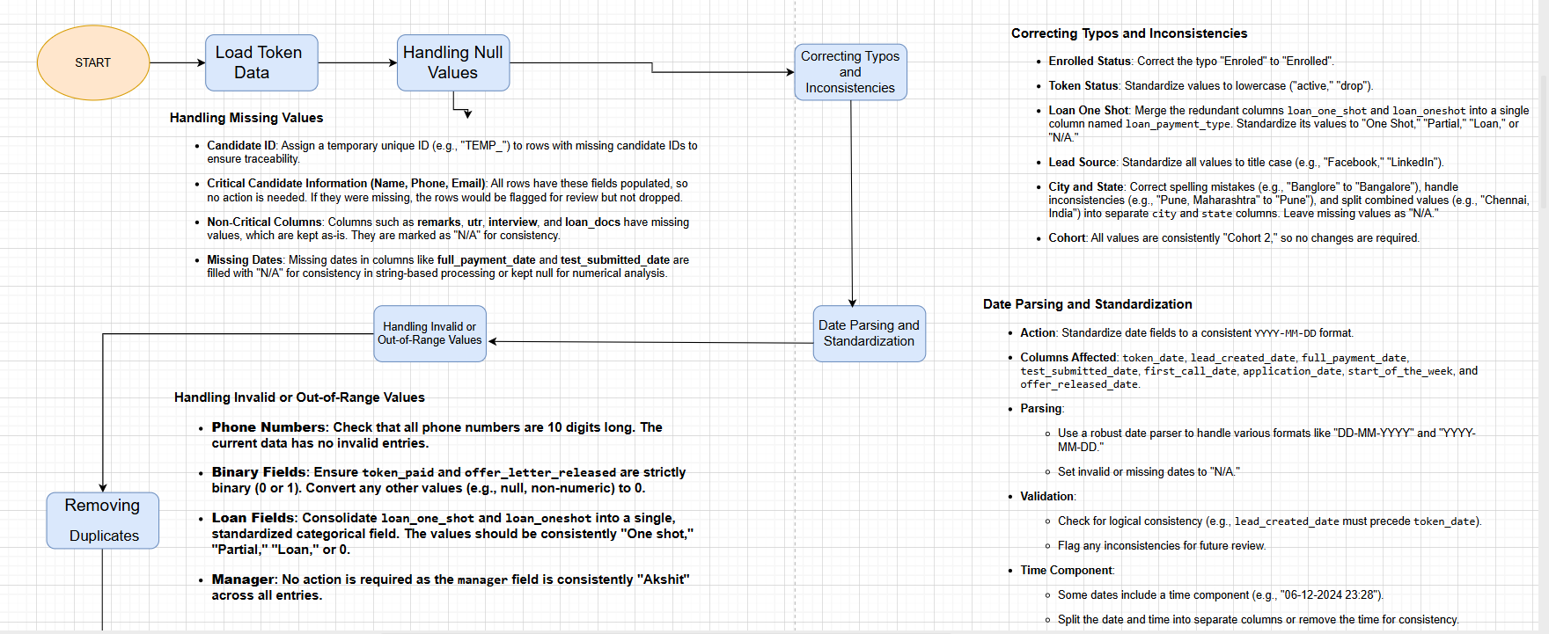
P.T.O
TOKEN DATASET
Notes:
1.7.2013
‹#›

Slide 18
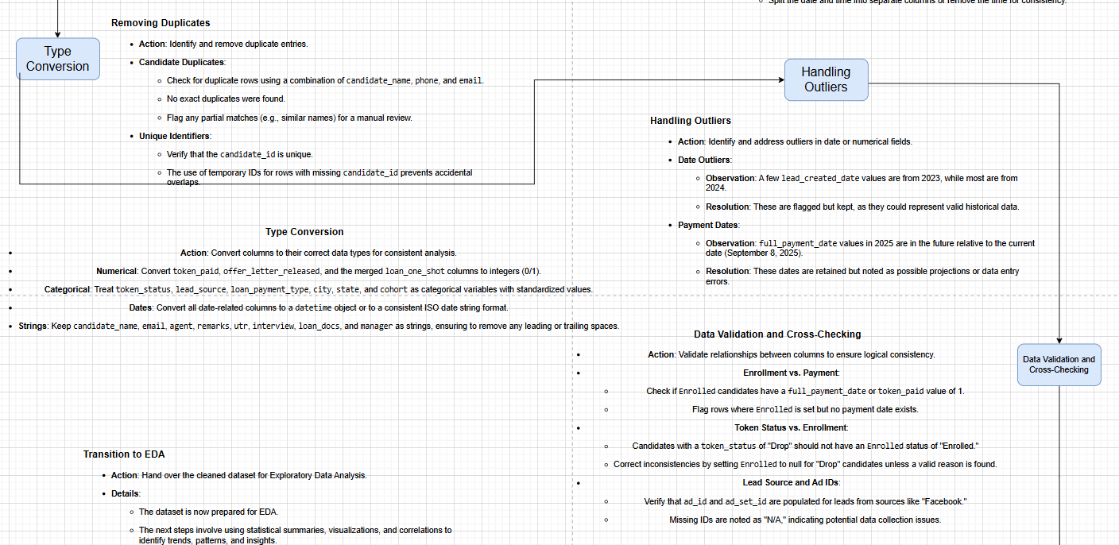
P.T.O
Notes:
1.7.2013
‹#›

Slide 19
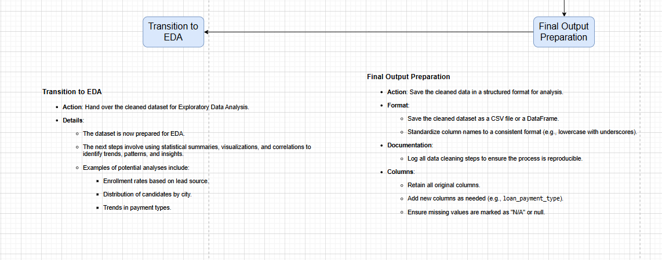
Notes:
1.7.2013
‹#›

Slide 20
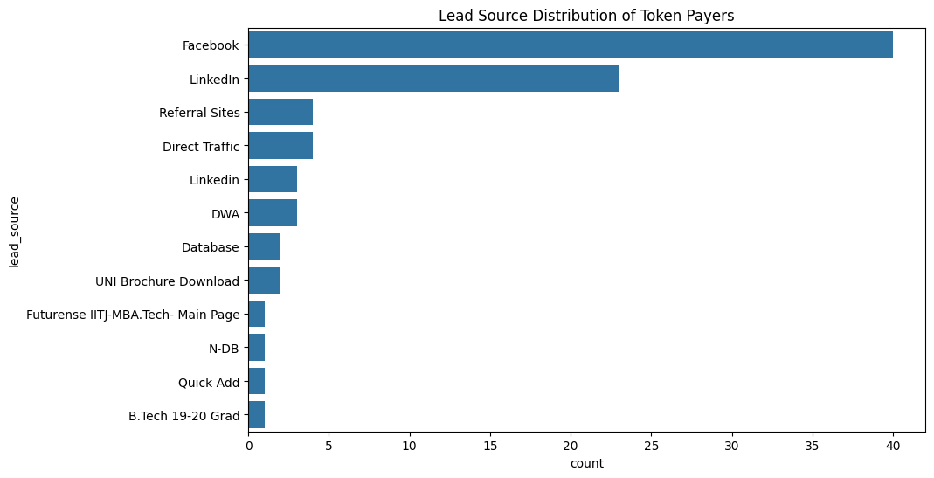
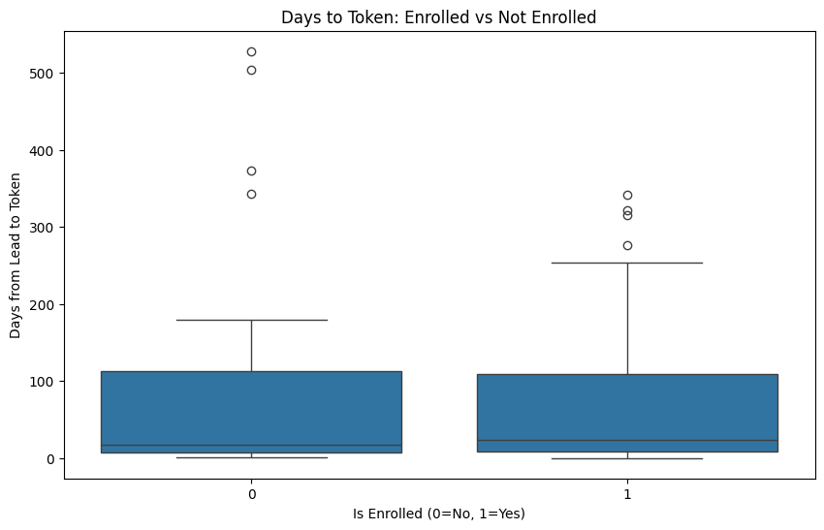
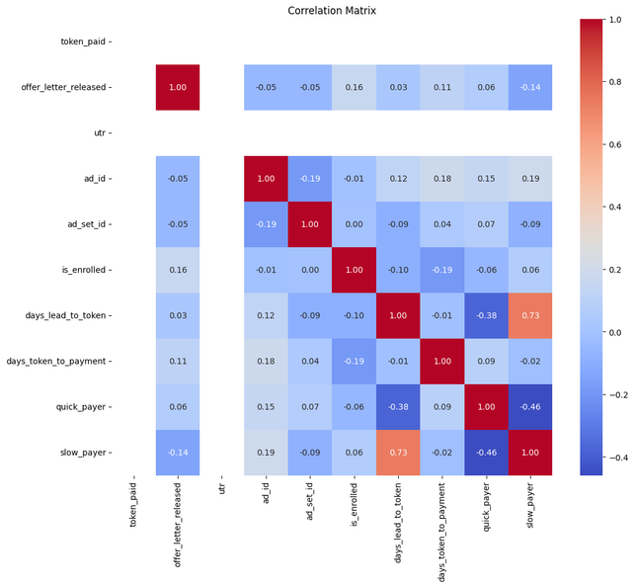
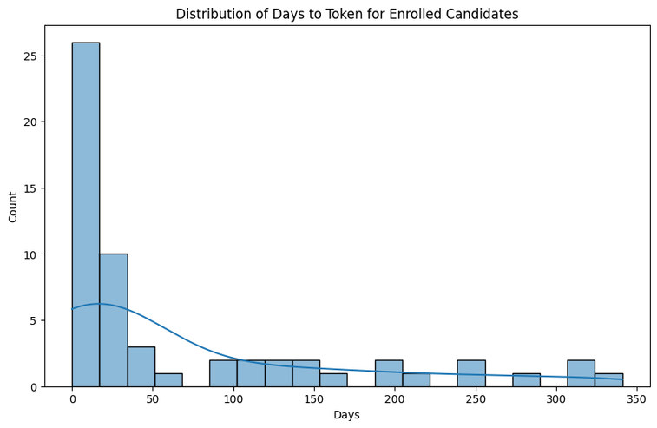
KEY-> EDA OUTPUT
FOR TOKEN DATASET

Slide 21
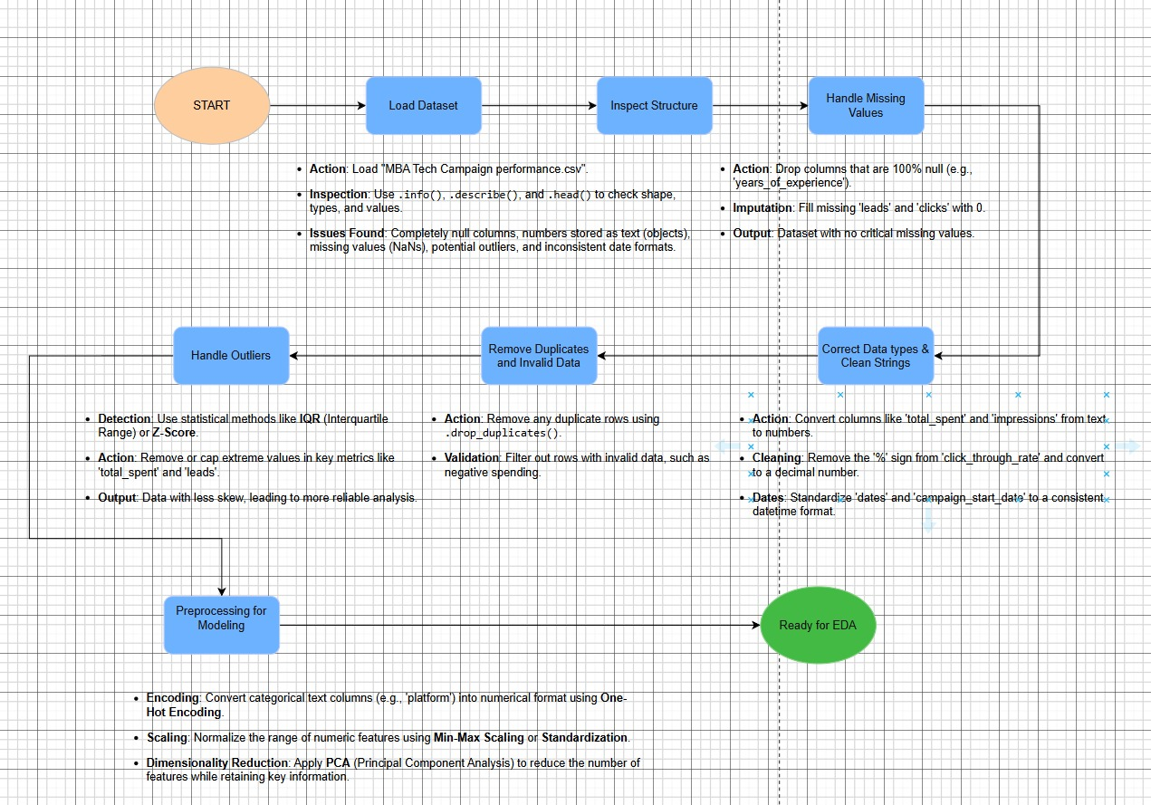
CAMPAIGN DATA SET
Notes:
1.7.2013
‹#›

Slide 22
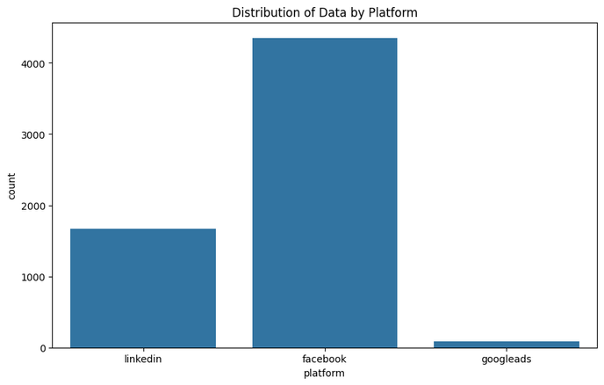
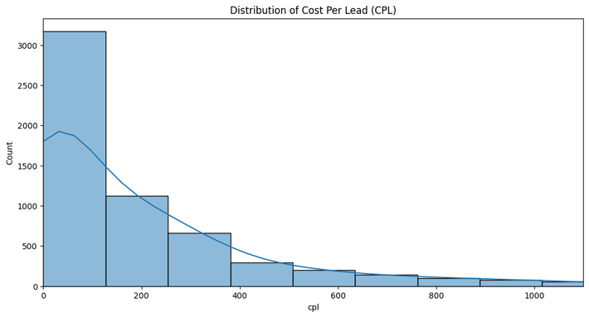
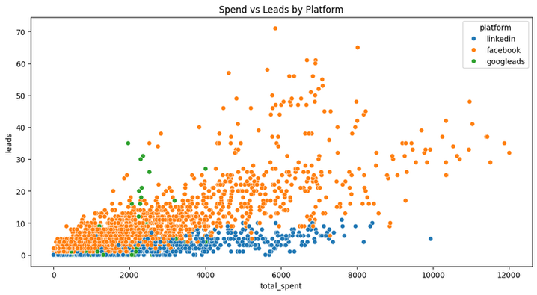
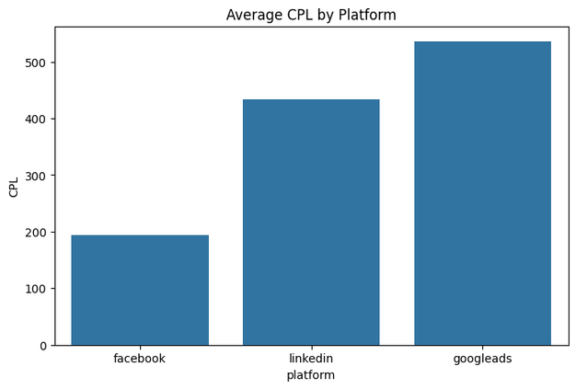
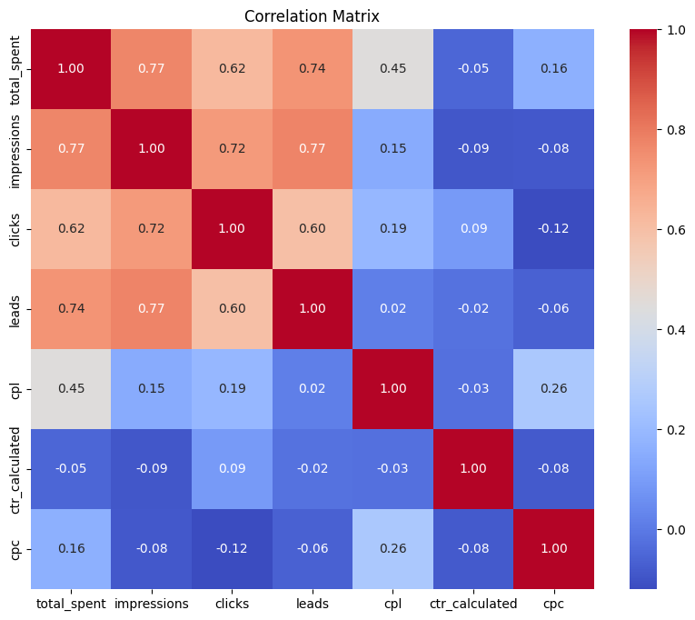
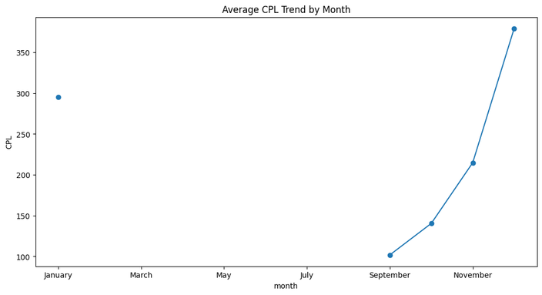
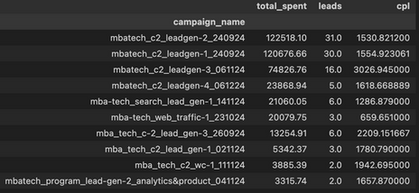
KEY-> EDA OUTPUT

Slide 23

Funnel Dataset: The Merged Journey
The Funnel dataset is the culmination of our data integration efforts, merging information from all previous stages to provide a holistic view of each candidate's journey.
Structure: A combined dataset, centrally organised by Lead IDs.
Comprehensive Tracking: Allows for end-to-end tracking of every candidate, from their initial interaction as a lead through to their final enrolment status.
Key for Analysis: Essential for calculating conversion rates between each stage, identifying precise drop-off points, and understanding the overall efficiency of the MBA admissions funnel.
Notes:
1.7.2013
10
‹#›

Slide 24
Analytical Approaches: Uncovering Data Relationships
Our analysis employed a multi-faceted approach to understand data characteristics and relationships:
Univariate Analysis
Multivariate Analysis
Distribution: Examined the spread and shape of individual variables.
Correlation Matrix: Identified linear relationships among multiple variables.
Frequency: Analyzed the occurrences of distinct values within a variable.
Pairplots: Visualized relationships between all pairs of variables in a dataset.
Bivariate Analysis
Visualization Techniques
Leads vs. Spend: Investigated the correlation between marketing expenditure and lead generation.
Histograms: Displayed data distribution.
Bar Charts: Compared categorical data.
Test Score vs. Enrollment: Explored the relationship between academic performance and successful enrollment.
Scatter Plots: Showed relationships between two numerical variables.
Heatmaps: Visualized correlation matrices.
Notes:
1.7.2013
5
‹#›

Slide 25
Feature Engineering: Crafting Predictive Power
Feature engineering is crucial for extracting more information from raw data, enhancing model performance. We focused on:
Derived Features
Funnel & ML Readiness
CTR (Click-Through Rate): Ratio of clicks to impressions.
Funnel Stages: Clearly defined stages of the customer journey (e.g., Lead, Application, Enrollment).
CPL (Cost Per Lead): Cost of acquiring each lead.
Leads per Click: Efficiency of clicks in generating leads.
Categorical Encoding: Converted categorical variables into numerical format suitable for machine learning models.
Conversion Time: Duration from initial interaction to conversion.
Scaling: Normalized numerical features to ensure they contribute equally to model training.
Notes:
1.7.2013
6
‹#›

Slide 26
Funnel Visualization: Tracing the User Journey
Understanding user progression through the sales or conversion funnel is critical for identifying bottlenecks. Our funnel visualization highlighted:
Key Stages & Drop-offs
Leads → Applications → Test → Token → Enrolled:
The defined pathway users follow.
Major Drop:
A significant reduction in users observed from the "Leads" to "Tests" stage, indicating a primary area for optimization.
Smaller Drop:
A less pronounced but still noticeable reduction from "Applications" to "Tokens," suggesting a secondary area for improvement.
Visulaisation:
Visualizing the funnel provides an intuitive overview of conversion rates and pinpoints stages where users disengage.
Notes:
1.7.2013
7
‹#›

Slide 27
Funnel Analysis: Quantifying Conversion Flow
A detailed look at the numbers at each stage of the funnel reveals conversion efficiency and potential areas for intervention:
~19.9K
~5-6K
~200-500
~85-100
Leads Generated
Applications Received
Tests Completed
Tokens Paid
The initial pool of potential customers attracted through various campaigns.
A substantial drop from leads, indicating the first major filter in the journey.
A dramatic reduction, highlighting the most significant bottleneck in the conversion process.
A much smaller drop, showing high intent from users who completed the test.
~60-70
Enrollments Achieved
The final conversion number, representing successful customer acquisition.
These numbers underscore the critical importance of optimizing the "Leads to Tests" stage to significantly boost overall enrollments.
Notes:
1.7.2013
8
‹#›

Slide 28
Campaign Performance: Driving Effective Lead Generation
Analyzing campaign performance is crucial for optimizing marketing spend and strategy. Our insights revealed:
Key Findings
This bar chart visually represents the comparative Cost Per Lead for different campaign channels, highlighting Facebook's cost-efficiency in lead generation.
Facebook Dominance: Linkedin emerged as the top platform for generating qualified leads, showcasing its effectiveness in reaching the target audience.
Optimal Timing: Evening hours (5–8 PM) consistently yielded the best lead conversion rates, suggesting prime engagement periods.
CPL Variation: Noted significant variations in Cost Per Lead (CPL) across different campaigns, indicating opportunities for cost optimization by focusing on more efficient channels.
Notes:
1.7.2013
9
‹#›

Slide 29
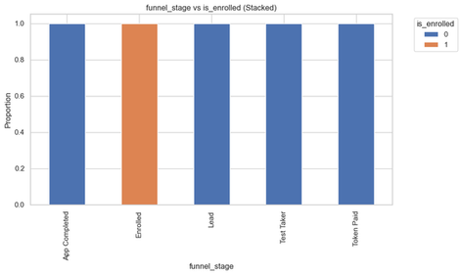
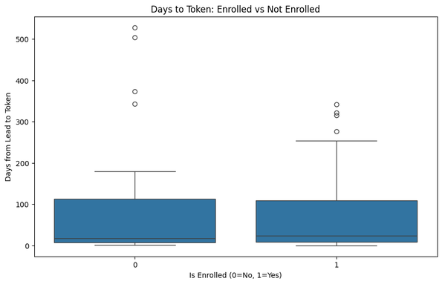
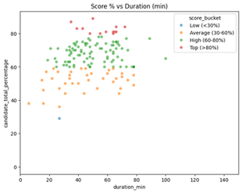
Application Analysis: Pathways to Enrollment
Understanding the characteristics of successful applicants is key to refining targeting strategies. Our analysis indicated:
Industry & Academic Impact
These visualizations provide a clear picture of which applicant segments are most likely to convert, enabling more targeted marketing and recruitment efforts.
Industry Conversion: Applicants from IT & Management backgrounds showed significantly higher conversion rates, suggesting a strong fit for our offerings.
Academic Performance: Students with higher scores in their XIIth grade and Graduation exhibited a greater propensity for enrollment, underscoring the importance of academic background.
Notes:
1.7.2013
10
‹#›

Slide 30
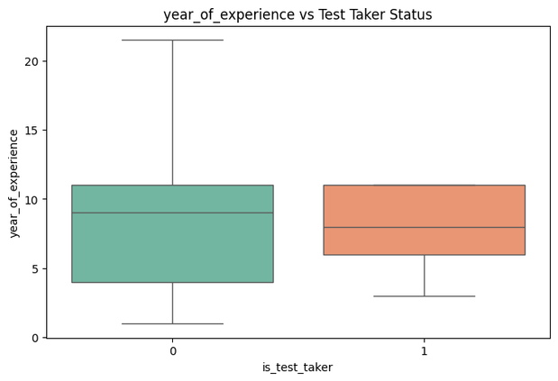
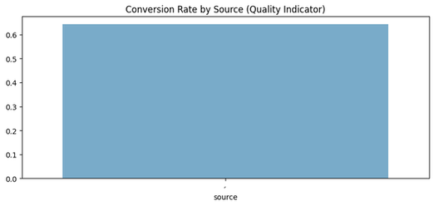
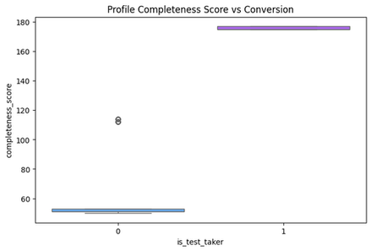
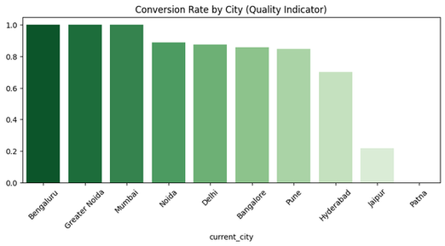
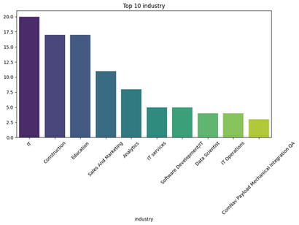
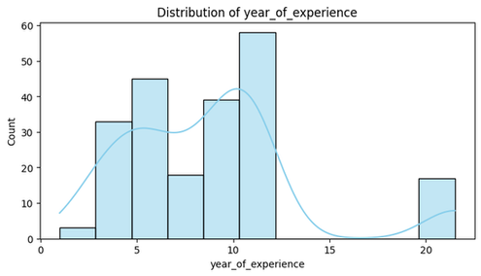
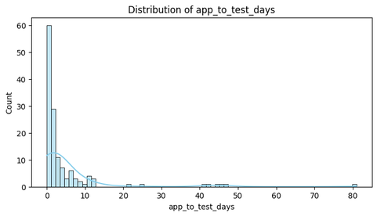
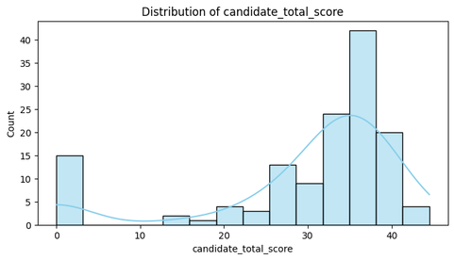
Evaluating Test Performance and Quality
Our analysis reveals a strong correlation between engineering backgrounds and tier-1 college graduates, indicating higher conversion rates post-test. We also noted a significant drop-off between the test completion and token payment stages, suggesting a potential bottleneck. Furthermore, suspicious test scores have been flagged for deeper investigation to maintain admission integrity.
Notes:
1.7.2013
1
‹#›

Slide 31
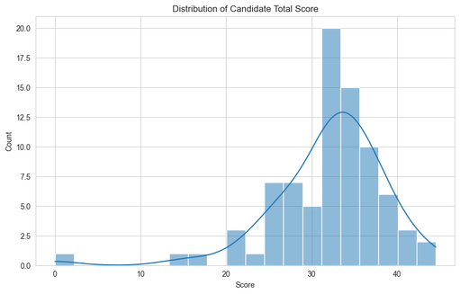
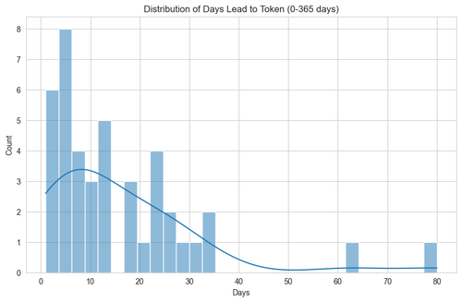




Token Conversion Insights: From Lead to Enrollment
Our data shows that Facebook and LinkedIn are the strongest sources for generating paid tokens, indicating their effectiveness in reaching our target audience. However, there's a noticeable drop in conversion after the token payment, suggesting potential issues in subsequent stages. Agent performance, particularly from Zoya and Sangeeta, has been exceptional in driving these conversions.
Notes:
1.7.2013
2
‹#›

Slide 32


Marketing ROI: Maximising Campaign Efficiency
An in-depth analysis of our marketing campaigns indicates that some initiatives have yielded a low return on investment (ROI), leading to wasted budget. By strategically reallocating our marketing spend to high-performing channels and refining our targeting, we project a potential efficiency gain of 20-30%. This shift will ensure our marketing budget is utilised more effectively.
This bar chart illustrates the ROI for various marketing campaigns, highlighting areas for budget reallocation and improved efficiency.
Notes:
1.7.2013
5
‹#›

Slide 33

Addressing Funnel Bottlenecks for Seamless Progression
The largest drop-off in our MBA enrollment funnel occurs between the 'Lead' and 'Test' stages, indicating a significant initial barrier. Another critical bottleneck is observed from 'Test' to 'Token payment', primarily due to process confusion and unclear next steps. Solutions include simplifying the interface for test registration and implementing automated reminders to guide candidates through each stage.
Token to Enrollment
Test to Token
Minor drop-off, usually due to final documentation or payment issues.
Lead to Test
Confusion regarding next steps post-test and financing delays are primary hurdles.
Largest drop-off. Candidates struggle with initial test registration or perceived complexity.
Notes:
1.7.2013
6
‹#›

Slide 34

Problems the Program is Facing (from Funnel Analysis)
1. High Drop-offs at Early Stages
The largest loss of candidates happens between Leads → Test.
This suggests either:
Lack of clarity/interest after initial sign-up.
Test instructions not engaging or too difficult.
Weak follow-up from admissions.
2. Application Stage Weakness
Many who attempt the test do not complete the Application.
Possible reasons:
Complex application form.
Lack of motivation/incentive to proceed.
Candidates losing interest before committing.

Slide 35

PowerBI Dashboard ScreenShot
Notes:
1.7.2013
10
‹#›

Slide 36

Suggestions / Recommendations
1. Improve Early Engagement (Leads → Test)
Send personalized follow-ups, reminders, and WhatsApp/email nudges.
Offer sample/mock tests to reduce anxiety.
Simplify test instructions, ensure mobile-friendly interface.
2. Simplify Application Process
Shorten the form, ask for minimal information first.
Add progress indicators (so candidates know how much is left).
Provide counselor/helpline support for doubts.
3. Regional Targeting
Double down on cities/segments with strong conversion.
Tailor ads in weaker regions (language, content, financial aid info).
4. Bridge Marketing & Admissions
Align marketing campaigns with admissions follow-up to avoid lead leakage.
Create a centralized CRM system for tracking every candidate’s stage.
5. Incentivize Progression
Offer early-bird scholarships or fee waivers for those completing application/token quickly.
Showcase success stories of alumni to motivate leads.

Slide 37

Summary and Conclusion
Approximately 20,000 leads result in 60-70 enrollments.
Campaign Return on Investment (ROI) varies widely.
Significant funnel leaks occur between the Lead to Test stage and the Test to Token stage.
IT/Management candidates and those from metro areas are the most promising.
Marketing ROI can improve 20–30%.
Funnel simplification + targeting → higher enrollments.
Data-driven decisions critical for admissions success.
Notes:
1.7.2013
11
‹#›

Slide 38

Any questions?
Notes:
1.7.2013
12
‹#›

